Slide 1
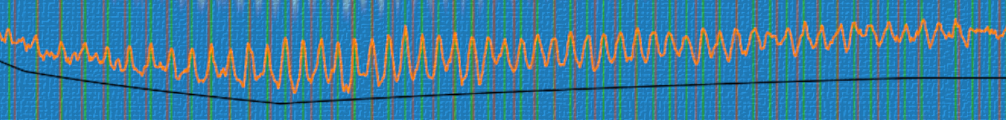
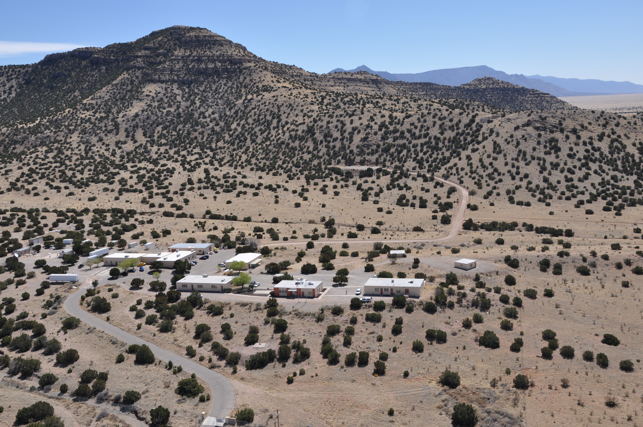

Where Does My Data Come From?
Adam Ringler aringler@usgs.gov

Slide 2
Goal
We want to be able to understand the diagram on the right at the end of all of this.
How do we record ground motions?
So time to get to it!

Slide 3
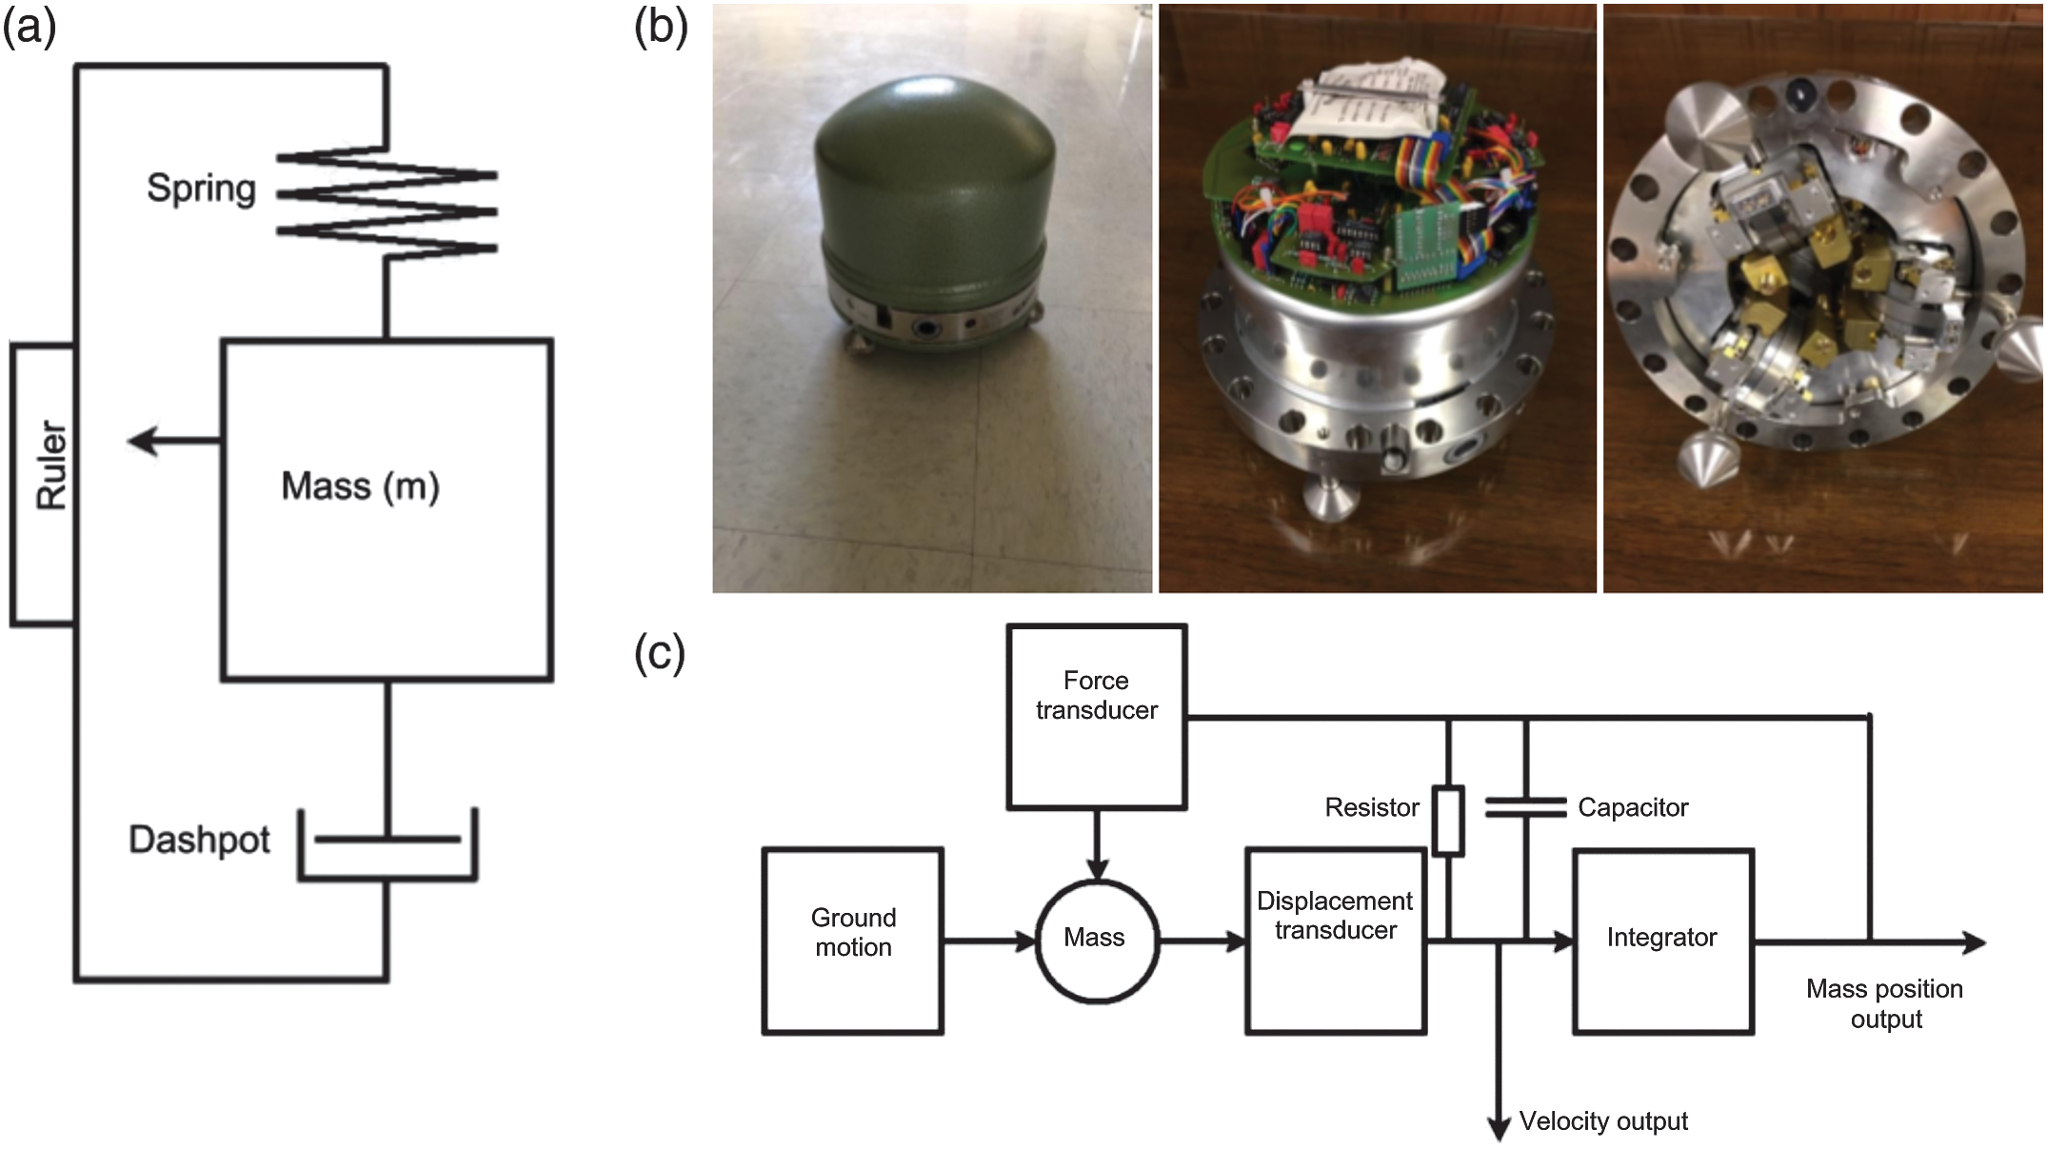
The Seismometer
Want to measure what the Earth is doing while we are on the Earth
Keep the mass stationary and measure the frame relative to the mass
The spring + dashpot make our recordings proportional to ground motion (F=ma + other terms)

Slide 4
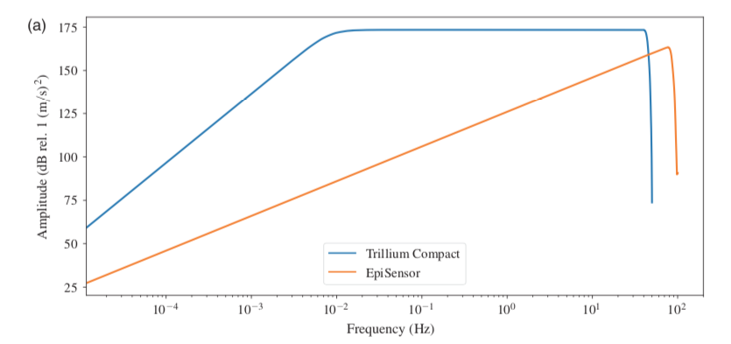
Feedback
To make our ruler bigger we keep the mass stationary via feedback and measure the voltage necessary to keep it stationary
This is proportional to velocity
If this makes no sense, ignore it!
Just remember: We need to correct for
the response!!!!!

Slide 5
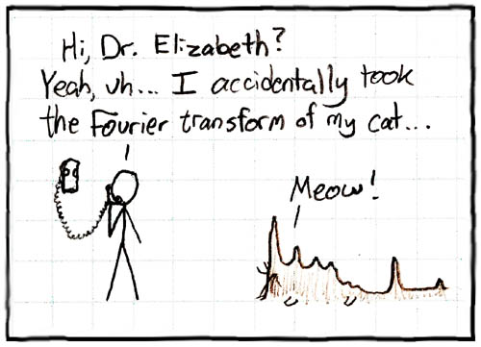
Frequency Domain
Write signal as a function of sine and cosine at various frequencies
Equation doesn’t matter. Just remember we are looking at amplitudes and their associated frequency

Slide 6
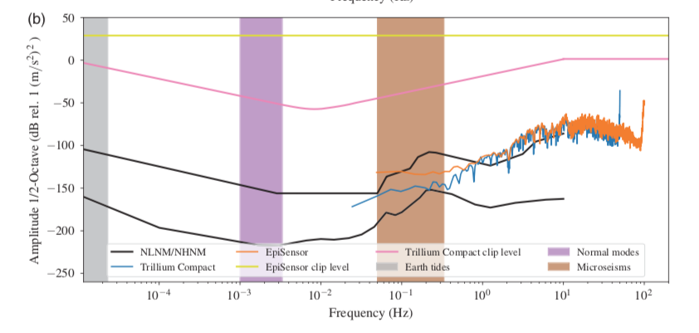


Frequency Domain
The big, the small the fast and the slow
The quality of our ruler/seismometer is how much of this we can record
Amplitudes
The equation doesn’t matter. All we care about are the amplitudes and their associated frequencies
Frequencies

Slide 7
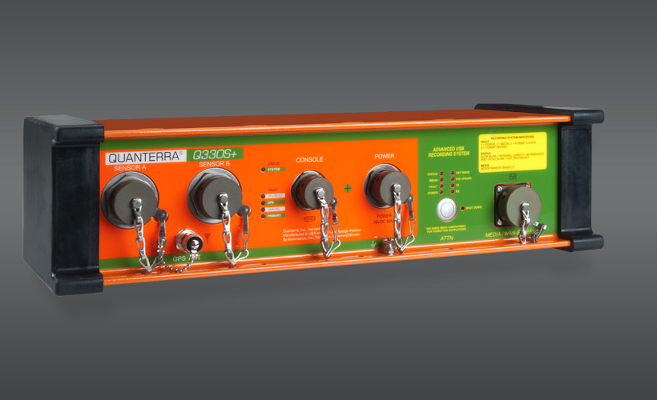
Digitizer
Seismometer outputs a voltage and we record it on a digitizer
Input is a Voltage and output is counts
Key feature: digitizer tags the data with the time!

Slide 8
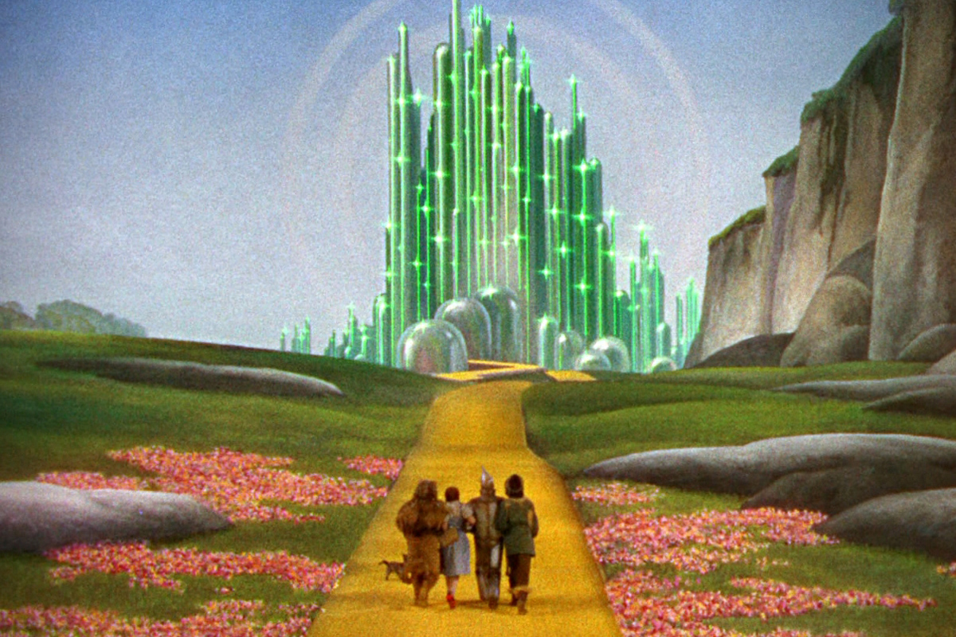
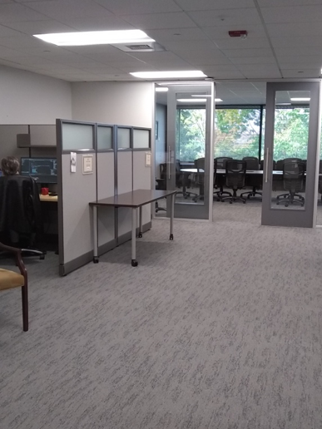
IRIS
The IRIS DMC, where your data goes!
Inside the DMC
Seismic data is available to the public at NO COST! Data sharing has been paramount to the evolution of the field

Slide 9
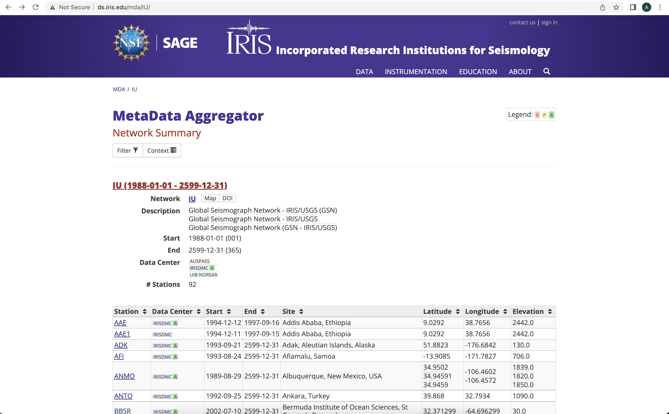
IRIS MDA
Lots of tools to inquire/understand the data you want as well as various tools

Slide 10
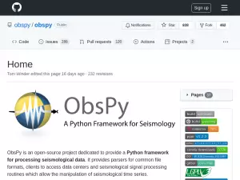
ObsPy and Data
Python open source package.
Available on github!
Large community base!

Slide 11
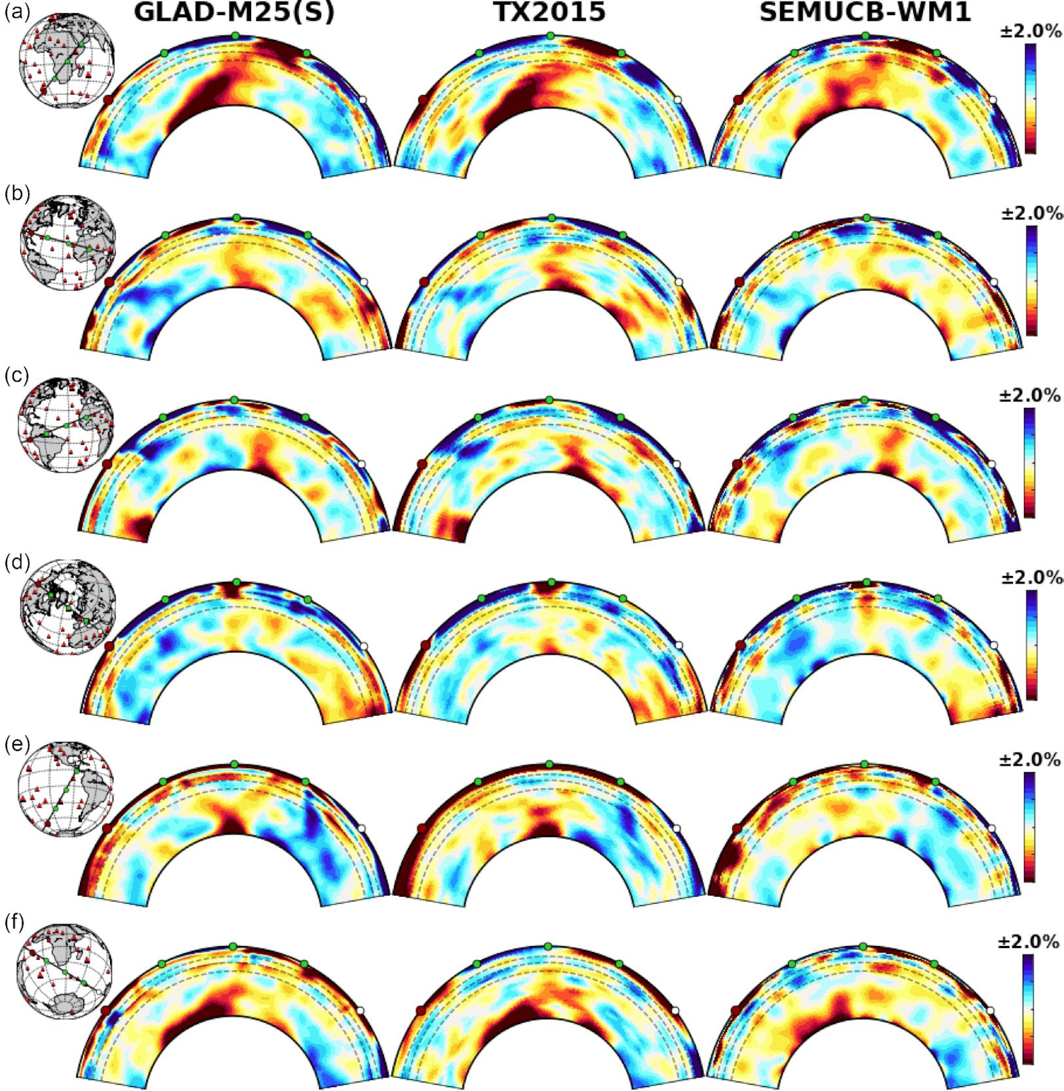
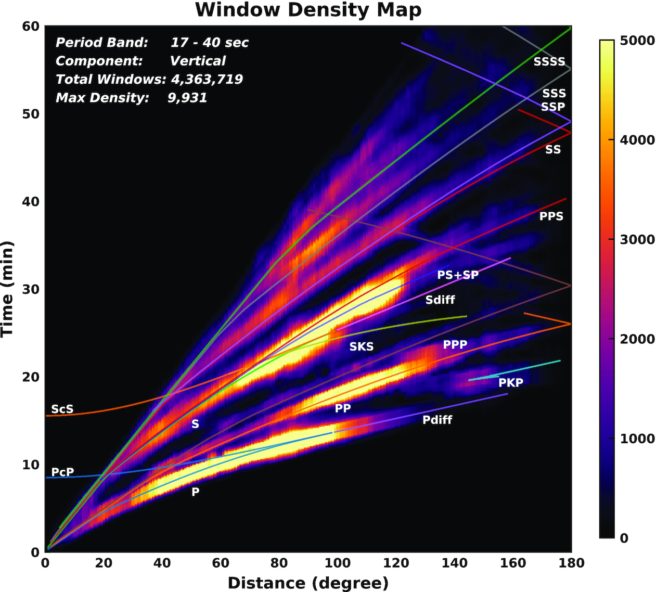
End Product
We have gone through the pieces of recording ground motion to data on your desktop, but skipped a few key pieces
From Lei et al. (2020)

Slide 12
Review Where We Are
Goal: Record ground motion and say important stuff about the Earth
Seismometer records ground motion and outputs volts
Digitizer takes voltage and turns into counts
IRIS takes our data
We request data and study the Earth
PROBLEM: Data comes out in counts NOT ground motion

Slide 13
SNCL Detour!
SNCL=Station, Network, Channel, Location
Network = 1 or 2 letter code that groups stations
Station = 4 or 5 letter code that describes the particular station
Location = To identify the sensor at the station, two letter code
Channel = Describes the sampling rate and the instrument (Vertical, North, East)
E.g.,
IU.ANMO.00.LHZ
Should really be called NSLC, but that doesn’t sound very good…
Exercise: Find a SNCL on the IRIS MDA

Slide 14
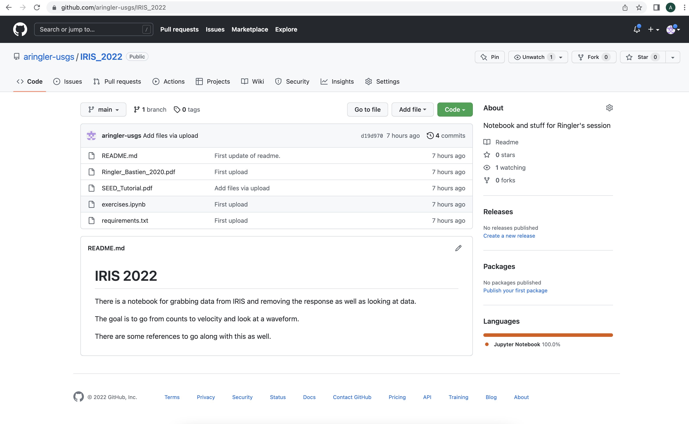
Time to Grab Some Data
Slides, notebooks, papers, etc. are all located on my github.
https://github.com/aringler-usgs/IRIS_2022

Slide 15
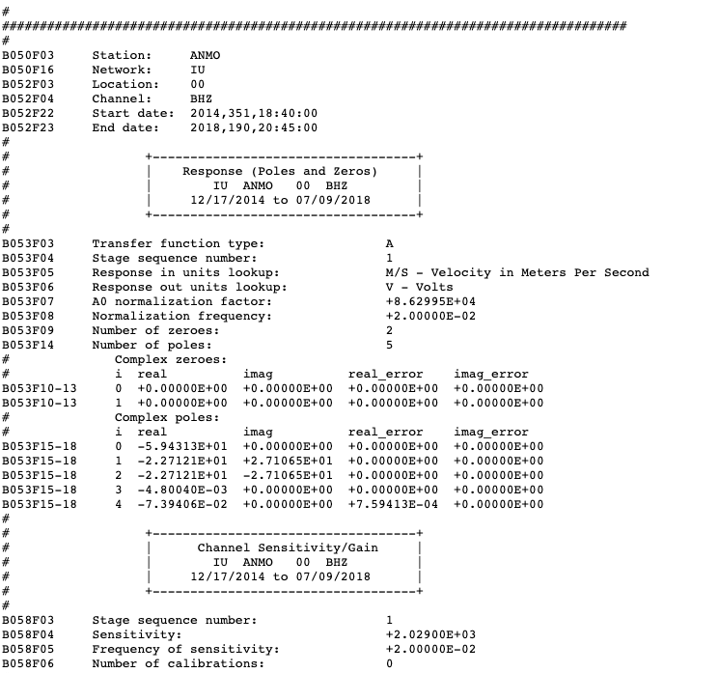
Electrical Sensitivity
The voltage the sensor puts out for a given input in the flat portion of the sensor

